Slide 1
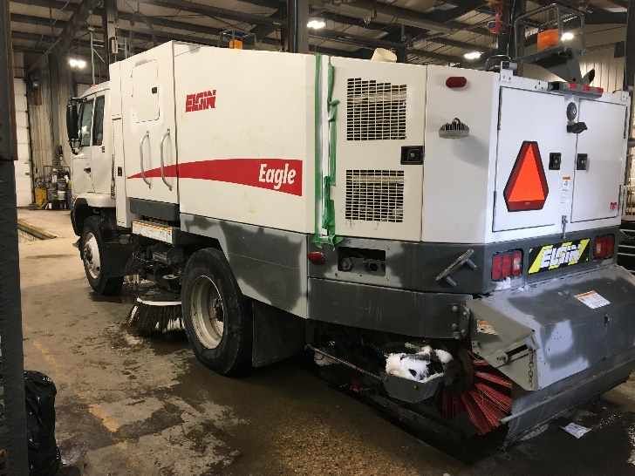
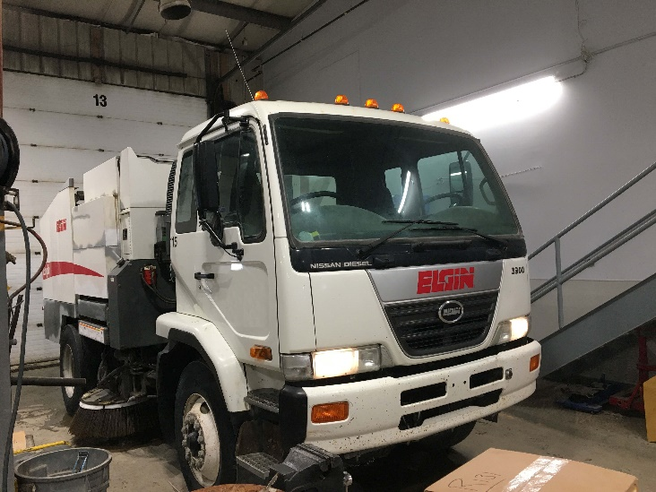
ELGIN EAGLE
CHASSIS
BODY
2010 UD Chassis With Dual Steer
230 HP / 6 Cylinder Diesel
Allison 2500RDS Automatic
11,900 LBS Front Axle
21,000 LBS Rear Axle
LH & RH High Back Cloth Seats
LH & RH Air Ride Seat
LH & RH Heated Remote Mirrors
Dual Mounted 8.5” Convex Mirrors
AC / Heat / AM /FM / CD / Block Heater
Vin: JNAP081L2AAC80275
S/N: F-2909-D
As Of May 18,19
4.5 Cubic Yard Hopper With Wash Down
49 HP John Deere Aux Engine Tier 3
10’ High Side Dump For Waste Containers
Dual 42” Side Brooms
60” Hydraulic Main Broom
Conveyor System With Wash Down
280+ Gallon Poly Water Tank
Low Water Indicator In Cab
Conveyor Stall Alarm
Resume Sweep After Transport
Hopper Full Alarm In Cab
Slow Moving Vehicle Sign
Front Spray Bar
Side Broom Tilt – LH & RH
LED Strobe With Guards Front & Rear
LED Hopper Light
Sale Price: $125,000.00
FOB: Innisfil
Available: 30 Days From PO
Subject To Availability, Freight & Applicable Taxes
STOCK: U025021 MILEAGE: 63,000 Miles
CHASSIS: 7,400 Hrs
1.866.737.8470 | jjei.com

